Slide 1

Thyroid Cancer Recurrence Prediction
BY
Shreyash Vishwakarma
© All rights reserved by Fireblaze Technologies Pvt. Ltd.

Slide 2
Problem Statement
Recurrence of thyroid cancer poses a major challenge for patient management.
The objective of this project is to predict whether a patient is likely to have recurrence using historical and medical data.
This helps doctors in early intervention and improved treatment planning.
© All rights reserved by Fireblaze Technologies Pvt. Ltd.

Slide 3
About the Data
Dataset: Differentiated_Thyroid_Cancer_Recurrence.csv
Features include:
- Demographics: Age, Gender
- Medical history: Smoking, Radiotherapy
- Clinical data: Thyroid Function, Adenopathy, Pathology
- Staging: T, N, M, Stage
- Target: Recurred (0 = No, 1 = Yes)
No missing values found in the dataset.
© All rights reserved by Fireblaze Technologies Pvt. Ltd.

Slide 4
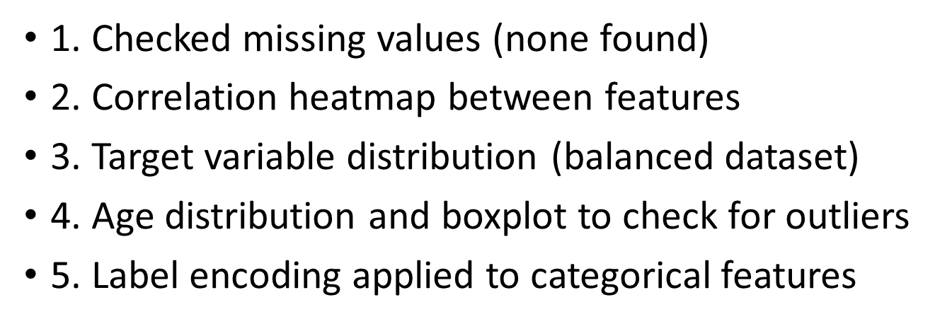
Exploratory Data Analysis
© All rights reserved by Fireblaze Technologies Pvt. Ltd.

Slide 5
Models Used
Trained and evaluated four models:
- Logistic Regression
- Decision Tree
- Random Forest
- K-Nearest Neighbors
Split dataset into 80% training and 20% testing.
© All rights reserved by Fireblaze Technologies Pvt. Ltd.

Slide 6
Conclusion
The Random Forest Classifier proved to be the most effective model for predicting thyroid cancer recurrence.
Key Insights:
- Achieved 98.7% accuracy
- Strong precision and recall for both classes
- Reliable for predicting minority class (recurred patients)
Helps doctors in clinical decision-making and preventive treatment
© All rights reserved by Fireblaze Technologies Pvt. Ltd.

Slide 7
Future Scope
Deploy the model as a clinical decision support tool.
Apply hyperparameter tuning for further performance improvement.
Handle larger and more imbalanced datasets.
Explore deep learning methods for complex medical data.
Integrate with hospital management systems for real-time prediction.
© All rights reserved by Fireblaze Technologies Pvt. Ltd.

